Slide 1
Neuromancer: Scientific Machine Learning Library for Modeling, Optimization, and Control
Physics-informed Machine Learning for Modeling, Control, and Optimization at the American Control Conference 2024
Ján Drgoňa, Rahul Birmiwal, Madelyn Shapiro, Bruno Jacob, Aaron Tuor, James Koch, Draguna Vrabie

Slide 2
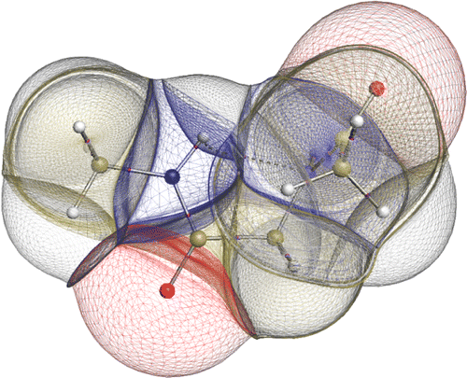

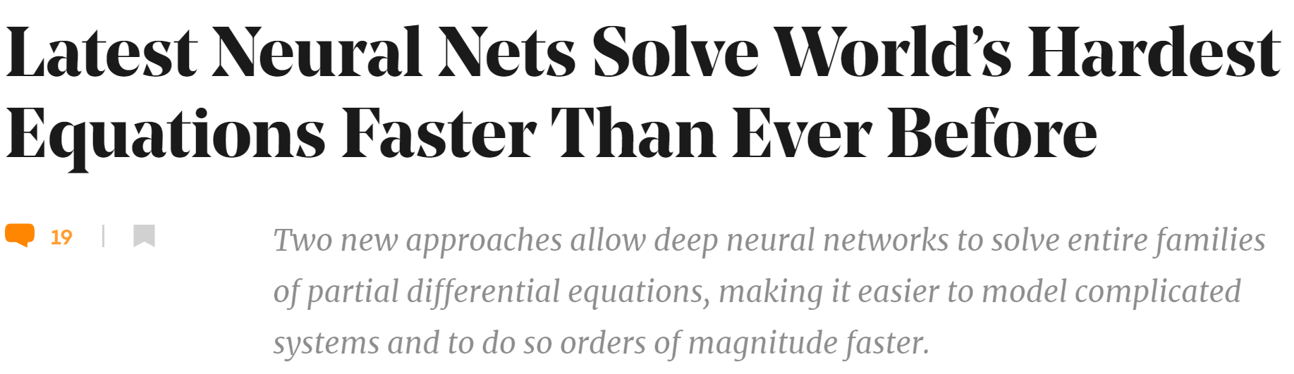
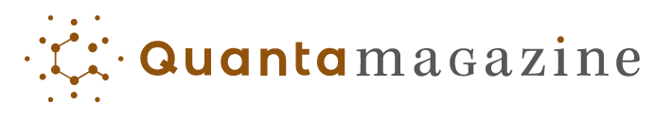
Challenges of Dynamical Systems Modeling and Control
Simulations are crucial for many areas of decision-making and scientific discovery
Need: Improve computational efficiency and scalability for heterogenous scientific simulations
Challenges:
Physically-consistent data-driven modeling
Fast simulation of complex systems
Optimal control and design of complex systems
Emerging solution:
Scientific Machine Learning connecting physics and AI domains

Slide 3
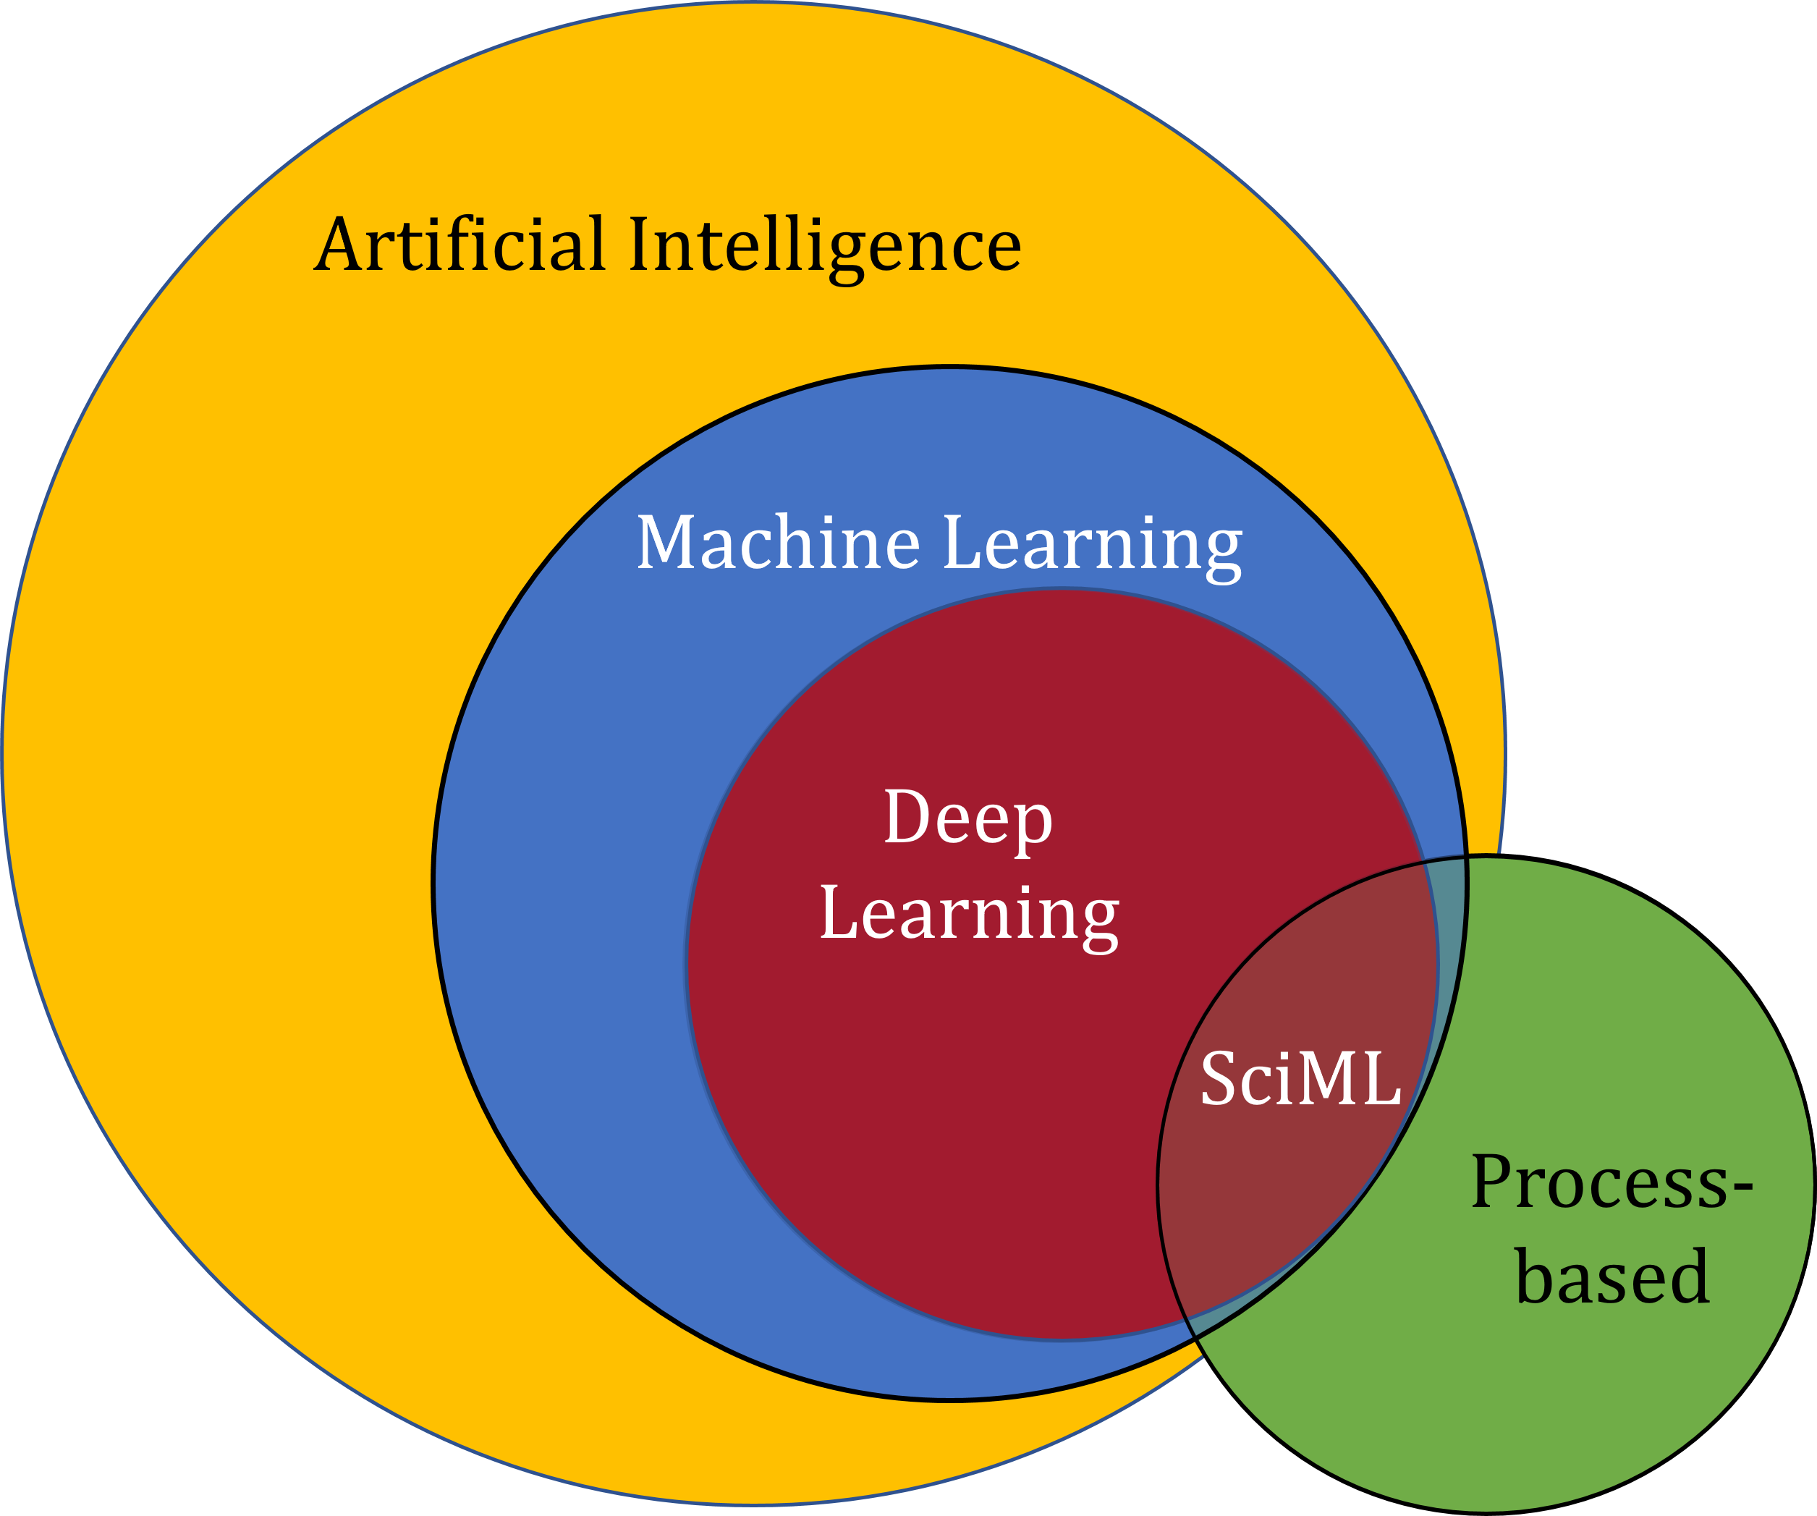
Scientific Machine Learning (SciML)
What?
SciML systematically integrates ML methods with mathematical models and algorithms developed in various scientific and engineering domains
Why?
Scientific applications are governed by fundamental principles and physical constraints
Purely data-driven “black box” ML methods cannot satisfy underlying physics
How?
Leverage automatic differentiation used in learning for modeling, optimization, and control
Karniadakis, G.E., Kevrekidis, I.G., Lu, L. et al. Physics-informed machine learning. Nat Rev Phys 3, 422–440, 2021.
Image source: https://sciml.wur.nl/reviews/sciml/sciml.html

Slide 4
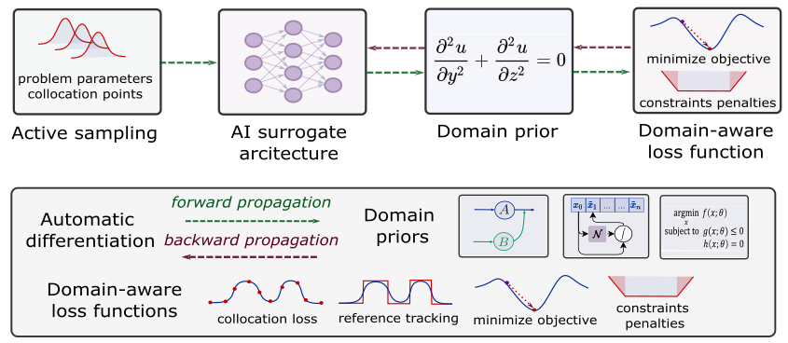
Landscape of SciML Methods
Karniadakis, G.E., Kevrekidis, I.G., Lu, L. et al. Physics-informed machine learning. Nat Rev Phys 3, 2021.
Thiyagalingam, J., Shankar, M., Fox, G. et al. Scientific machine learning benchmarks. Nature Reviews Physics 4, 413–420, 2022.
Nghiem T., Drgona J., et al. Physics-Informed Machine Learning for Modeling and Control of Dynamical Systems, ACC, 2023.

Slide 5
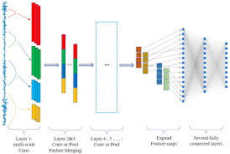
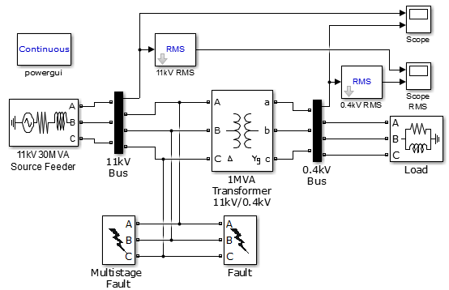
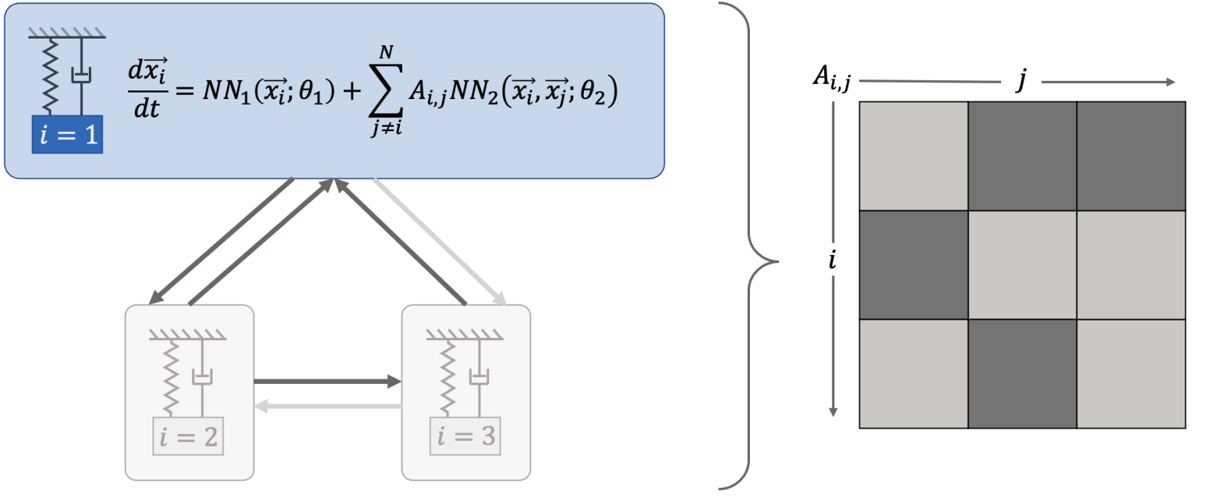
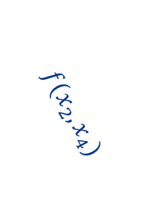
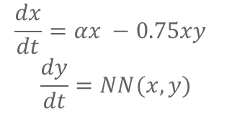

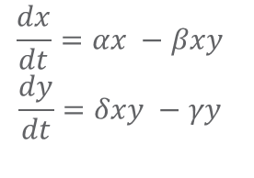
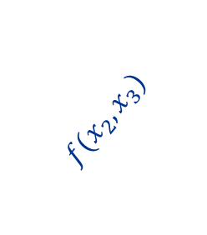
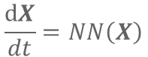
Landscape of Modeling Methods
White-box
Gray-box
Black Box
$$\frac{dx}{dt}=αx −βxy$$
$$\frac{dy}{dt}=δxy −γy$$
$$\frac{dx}{dt}=αx −0.75xy$$
$$\frac{dy}{dt}=NN(x,y)$$
$$\frac{dX}{dt}=NN\left(X\right)$$
More domain knowledge
Less domain knowledge
physics-based
networked neural ODEs
neural differential equations
state space models
physics priors
graph neural networks
3
$$f(x_{2},x_{3})$$
$$f(x_{2},x_{1})$$
1
2
$$f(x_{2},x_{4})$$
4

Slide 6

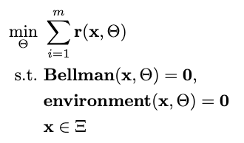

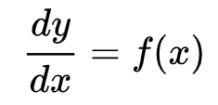

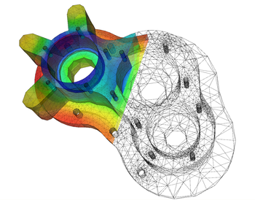
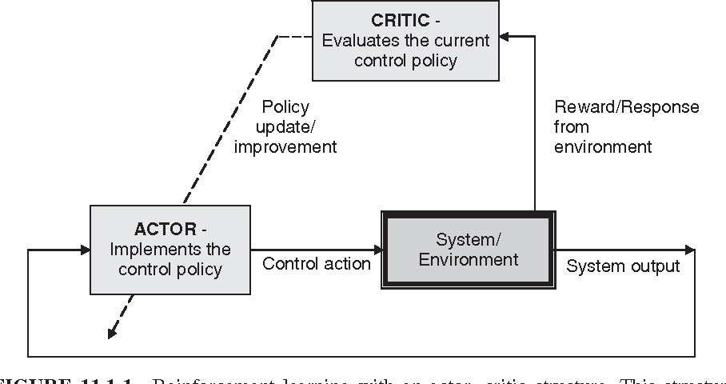

Landscape of Solution Methods
Constrained optimization
Differential equations
Supervised Learning
Reinforcement Learning
Requires prior knowledge of objective function and constraints
Requires prior knowledge of the physics to be modeled
Requires large labeled datasets
Requires environment model to sample
More domain knowledge
Less domain knowledge

Slide 7




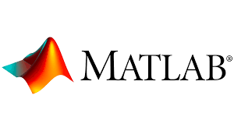




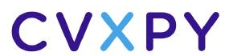






Landscape of Solution Tools
Constrained optimization
Differential equations
Supervised Learning
Reinforcement Learning
More domain knowledge
Less domain knowledge

Slide 8
Differentiable Programming
Differentiable Programming
M. Innes, et al., A Differentiable Programming System to Bridge Machine Learning and Scientific Computing, 2019
Learning to Model
B. Lusch, N. Kutz, S. Brunton, Deep learning for universal linear embeddings of nonlinear dynamics, 2018
R. T. Q. Chen, et al., Neural Ordinary Differential Equations, 2019
M. Raissi, et al., Physics-informed neural networks: A deep learning framework for solving forward and inverse problems involving nonlinear partial differential equations, 2019
C. Rackauckas, et al., Universal Differential Equations for Scientific Machine Learning, 2021
Learning to Optimize
A. Agrawal, et al., Differentiable Convex Optimization Layers, 2019
P. Donti, et al., DC3: A learning method for optimization with hard constraints, 2021
S. Gould, et al., Deep Declarative Networks: A New Hope, 2020
J. Kotary, et al., End-to-End Constrained Optimization Learning: A Survey, 2021
Learning to Control
B. Amos, et al., Differentiable MPC for End-to-end Planning and Control, 2019
S. East, et al., Infinite-Horizon Differentiable Model Predictive Control, 2020
A. Agrawal, et al., Learning Convex Optimization Control Policies, 2020.
Y Qiao, et al., Scalable Differentiable Physics for Learning and Control, 2020.

Slide 9
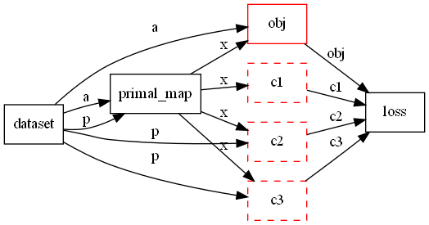
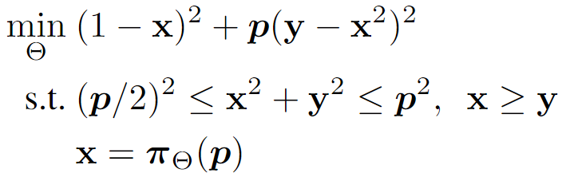
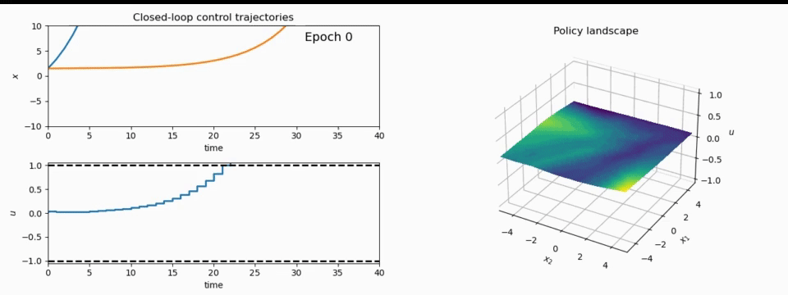
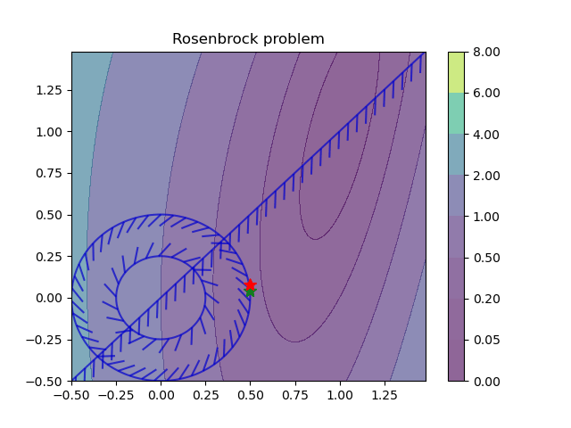
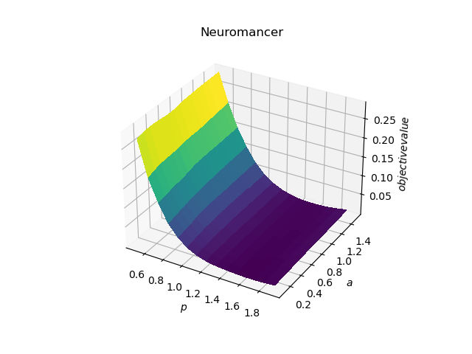
NeuroMANCER: a Scientific Machine Learning Library
1. Mathematical formulation
3. Problem graph
map
2. Python code interface
4. Results
import neuromancer as nm
p = nm.variable(‘p’)
x = nm.variable(‘x’)
y = nm.variable('y’)
obj = ((1-x)**2 + p*(y-x**2)**2).minimize(weight=1.0, name='obj’) c1 = (p/2)**2 <= x**2 + y**2
c2 = x**2 + y**2 <= p**2
c3 = x >= y net = nm.MLP(insize=2, outsize=2, hsizes=[80]*4) map = nm.Node(net, input_keys=['p’], output_keys=[‘x’,‘y’])
loss = nm.PenaltyLoss([obj], [c1, c2, c3]) problem = nm.Problem([map], loss)
optimizer = torch.optim.AdamW(problem.parameters()) trainer = nm.Trainer(problem,data,optimizer)
best_model = trainer.train()

Slide 10
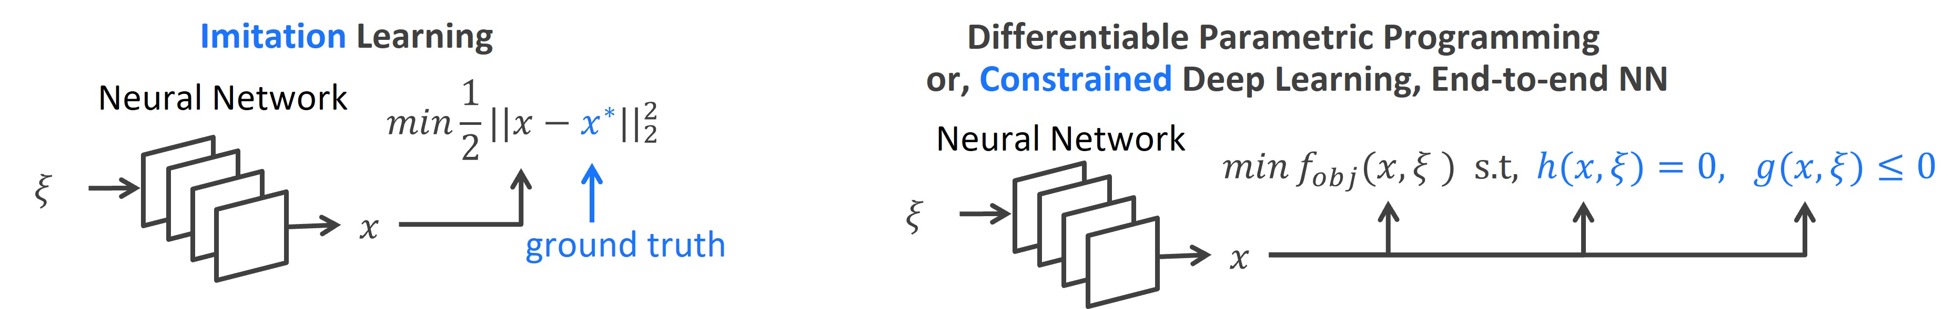
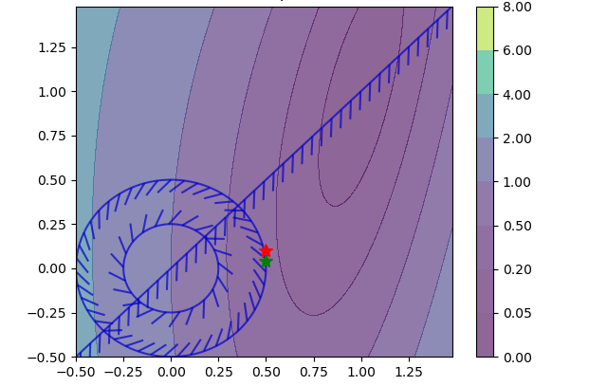
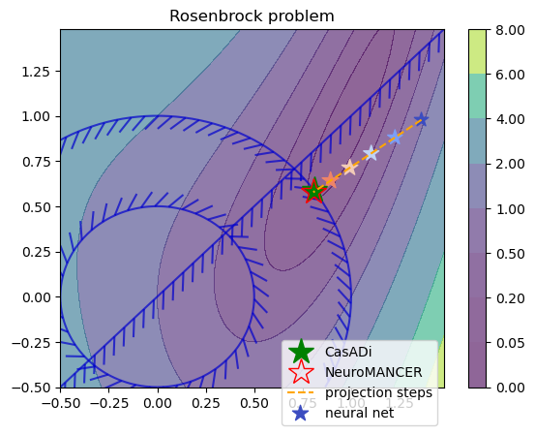
Learning to Optimize in Neuromancer
Training neural networks as explicit solutions
Feasibility restoration with implicit layers

Slide 11
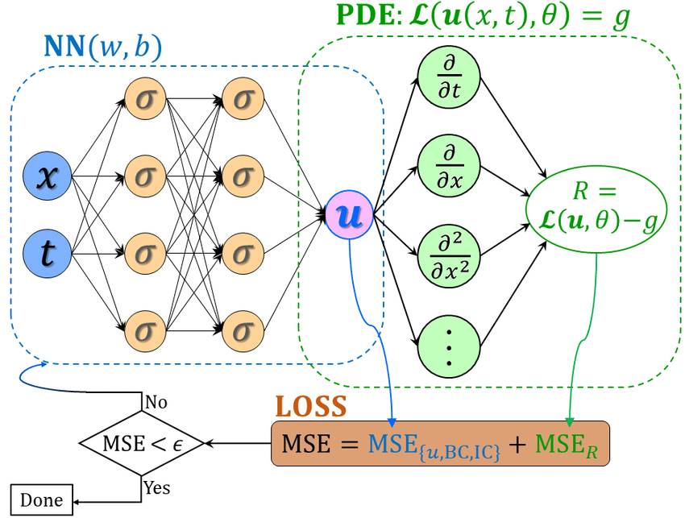
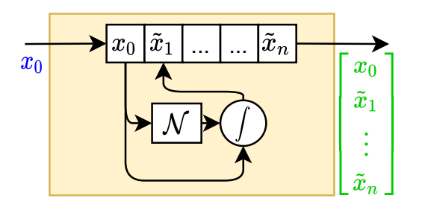
Learning to Model in Neuromancer
Component-based Physics-informed Machine Learning
Physics-Informed Neural Networks
Networked Dynamical systems
Neural differential equations

Slide 12
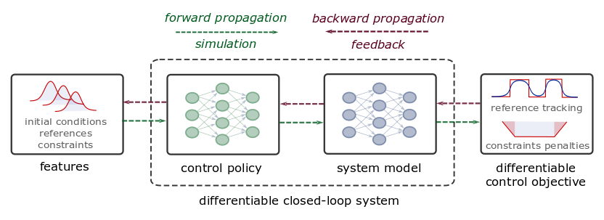
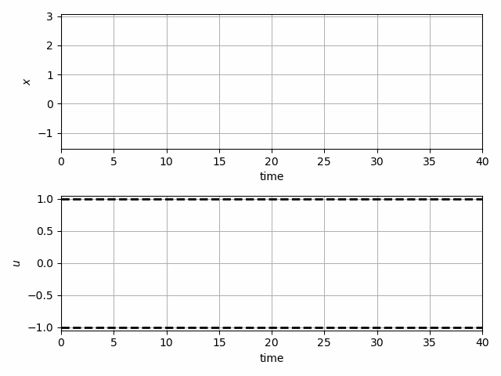
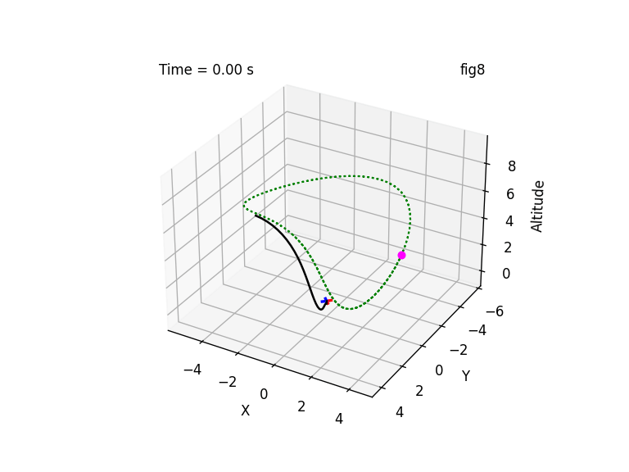
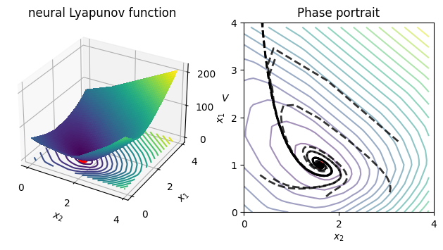
Learning to Control in Neuromancer
Differentiable predictive control
Learning stabilizing controllers
Trajectory optimization and obstacle avoidance
Learning Energy Functions

Slide 13



NeuroMANCER
Open-source scientific machine learning (SciML) toolbox in Pytorch integrating deep learning, constrained optimization, and physics-based modeling
Learning to optimize
Learning to control
Nonlinear system identification
Physics-informed neural networks
github.com/pnnl/neuromancer
www.youtube.com/@neuromancer_SciML

Slide 14





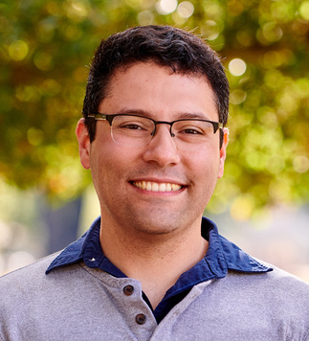
Acknowledgements
Core Development Team
Ján Drgoňa
Diff Predictive Control
Aaron Tuor
Deep Learning
Madelyn Shapiro
Deep Learning
Rahul Birmiwal
Software Development
Bruno Jacob
Dynamical Systems
Draguna Vrabie
Predictive Control

Slide 15

Hiring!
Starting a new group at the Department of Civil & Systems Engineering at Johns Hopkins University
Multiple PhD and postdoc opportunities
Starting January 2025
Focus on Scientific Machine Learning for dynamics, optimization, and control
Applications in energy systems
drgona.github.io

